Slide 1
Power BI Custom Visual Update for 2019

Slide 2
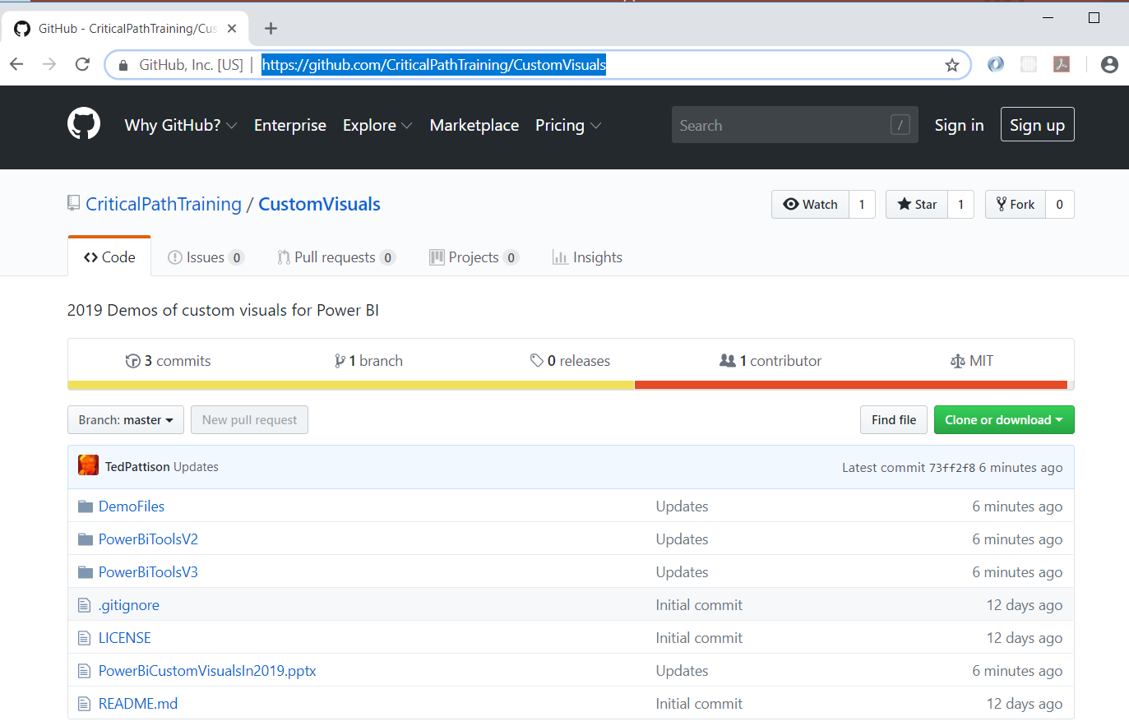
Slides and Sample Code for This Webinar
https://github.com/CriticalPathTraining/CustomVisuals

Slide 3
Agenda
Installing the Power BI Developer Tools
Creating Your First Custom Visual
Defining Data Roles and Data Mappings
Extending a Visual with Custom Properties
Migrating to Version 3 of the Power BI Developer Tools

Slide 4
Installing the Power BI Developer Toolchain
Install Node.JS
Installs Node Package Manage (npm)
Install Visual Studio Code
Lightweight Alternative to Visual Studio for Node.js Development
Install the Power BI Developer Tools (pbiviz)
Install using Node Package Manager (npm)
Create and install a local self-signed certificate
Install using Power BI visuals CLI tool (pbiviz)

Slide 5
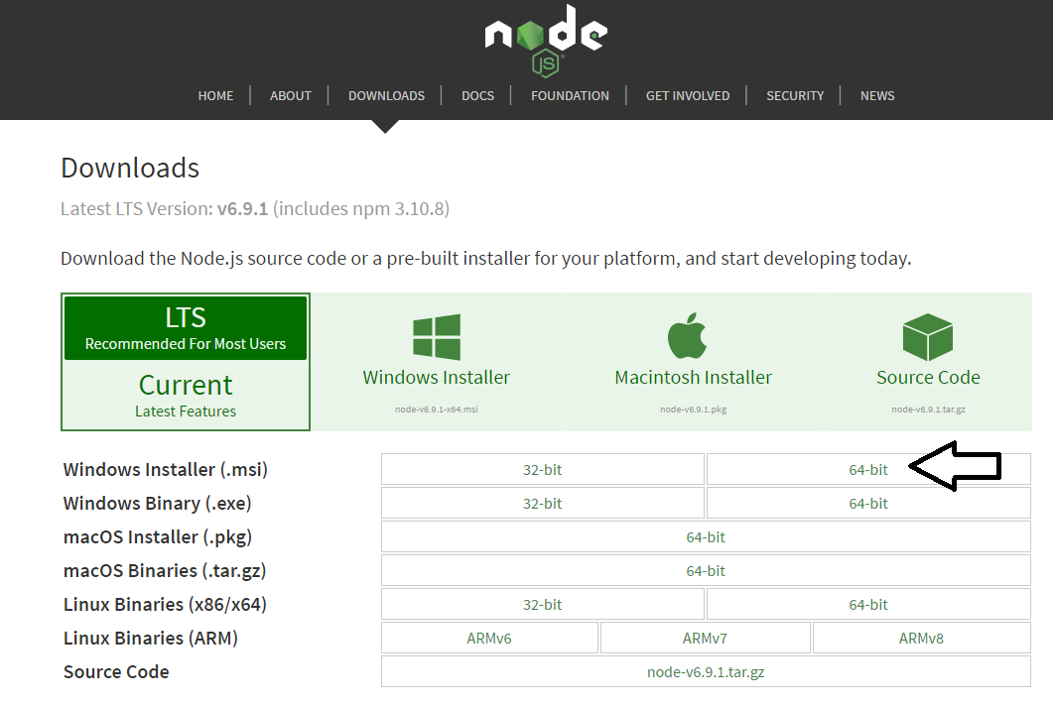
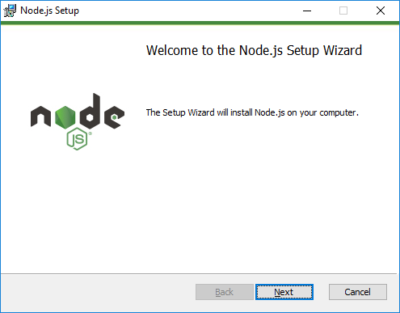
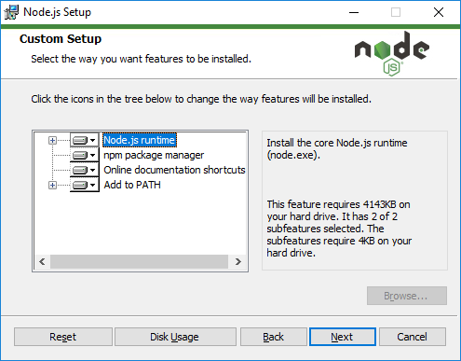
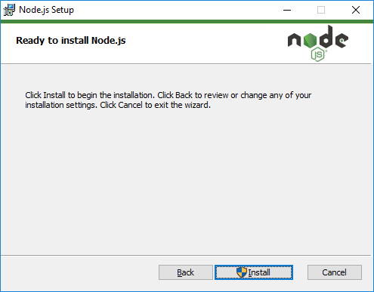
Installing node.js
https://nodejs.org/en/download/

Slide 6
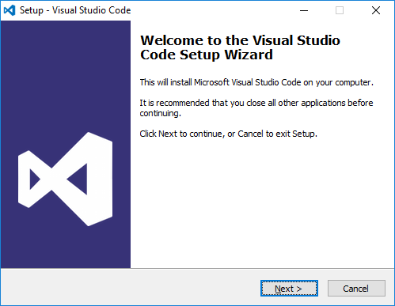
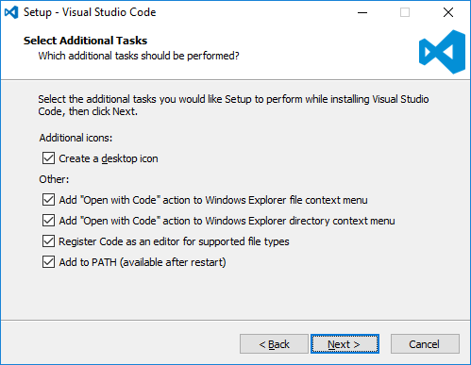
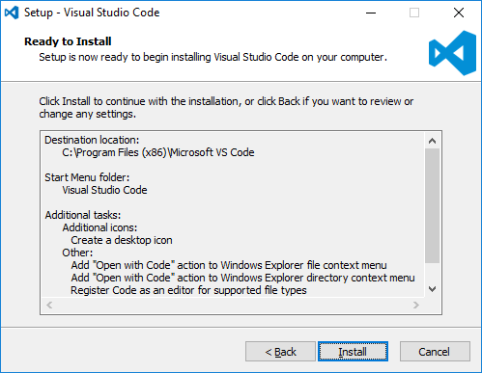
Install Visual Studio Code
http://code.visualstudio.com/

Slide 7
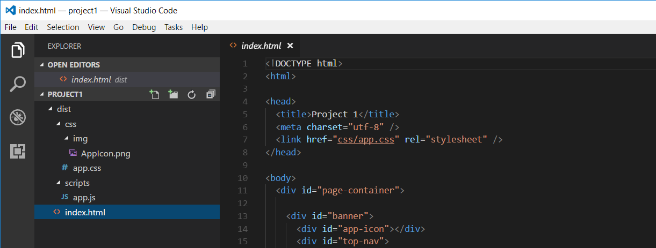
Developing with Visual Studio Code
Node.js is agnostic when it comes to developer IDE
There are many different IDEs that people use with Node.js
This course will be using Visual Studio Code
Visual Studio is not a good fit for Node.js development
Visual Studio solution & project files incompatible with Node.js

Slide 8
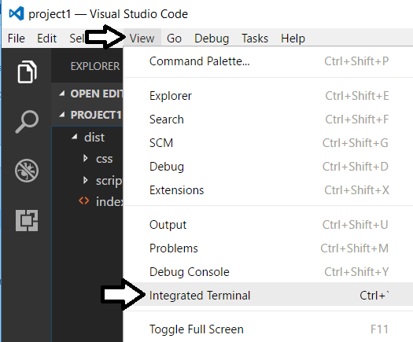
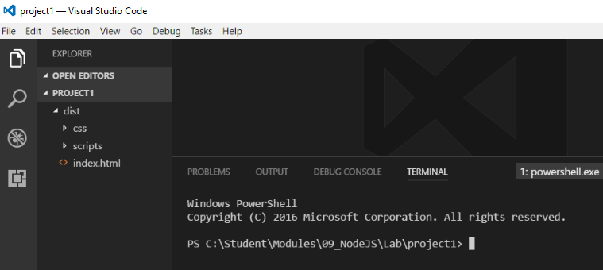
Integrated Terminal
Use the Integrated Terminal to execute npm command

Slide 9
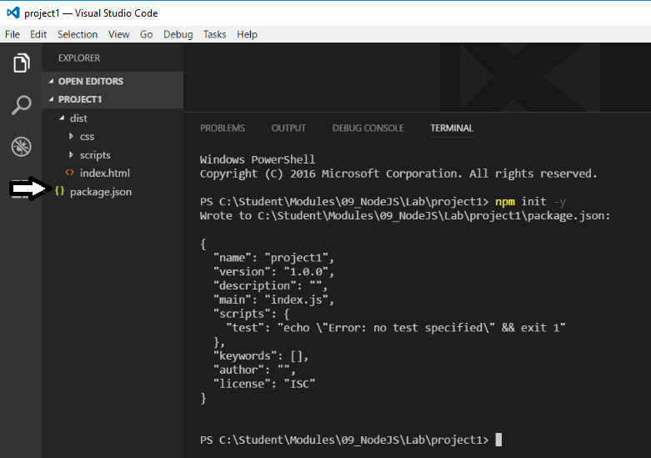
npm init
Node.js projects initialized with npm init command
This command created the package.json file

Slide 10
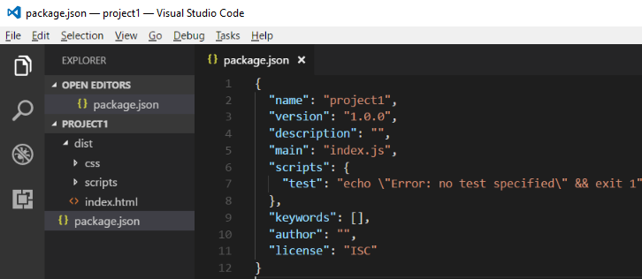
package.json
package.json serves as project manifest file
Tracks project name and version number
Tracks installed package dependencies

Slide 11
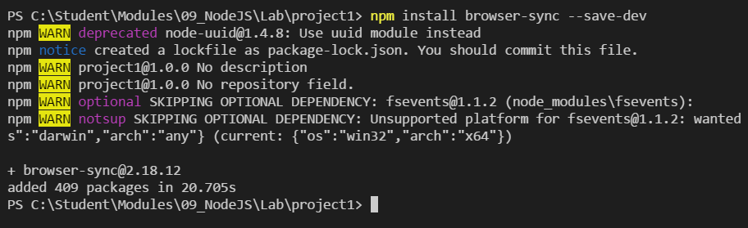
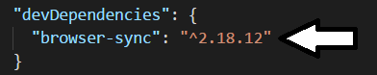
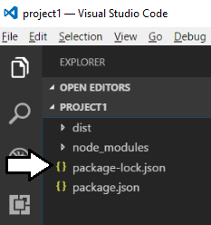
Installing Packages

Slide 12
What is TypeScript?
A programming language which compiles into plain JavaScript
A superset of JavaScript that adds a strongly-typed dimension
It can be compiled into ECMAScript3, ECMAScript3 or ECMAScript 6
It runs in any browser, in any host and on any OS
product.ts
product.js
TypeScript
Compiler
Notes:
There is a getting started tutorial at https://www.typescriptlang.org/docs/tutorial.html .

Slide 13
Type Annotation
TypeScript allows you to annotate types
Provides basis for strongly-typed programming
Type annotations used by compiler for type checking
Type annotations are erased at the end of compile time

Slide 14
Arrow Function Syntax
TypeScript supports arrow function syntax
Concise syntax to define anonymous functions
Can be used to retain this pointer in classes

Slide 15
Classes
TypeScript supports defining classes
Class defines type for object
Export keyword makes class created across files
Class can be passed as factory function
Default accessibility is public

Slide 16
Class Constructors
Constructor parameters become fields in class
Client-side code calls constructor using new operator

Slide 17
Interfaces
Interface defines a programming contract
Classes can implement interfaces
Client code can be decoupled from concrete classes

Slide 18
TypeScript Definition Files (d.ts)
What are TypeScript definition files
Typed definitions for 3rd party JavaScript libraries
DefinitelyTyped provides great community resource
Typed definition files have a d.ts extension

Slide 19
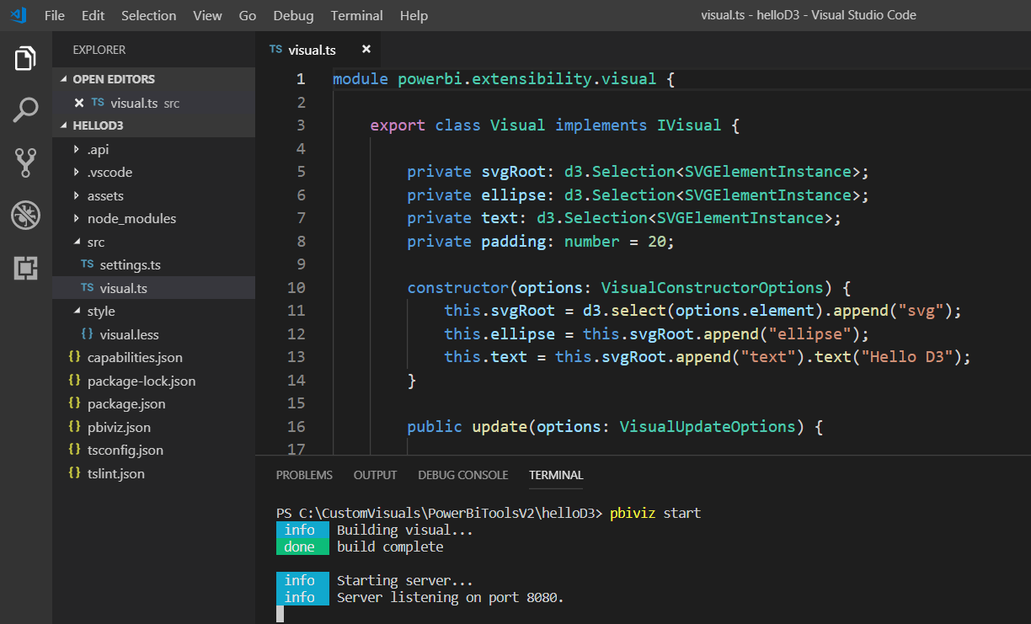
Developing with Visual Studio Code
Provides great development experience with node.js

Slide 20
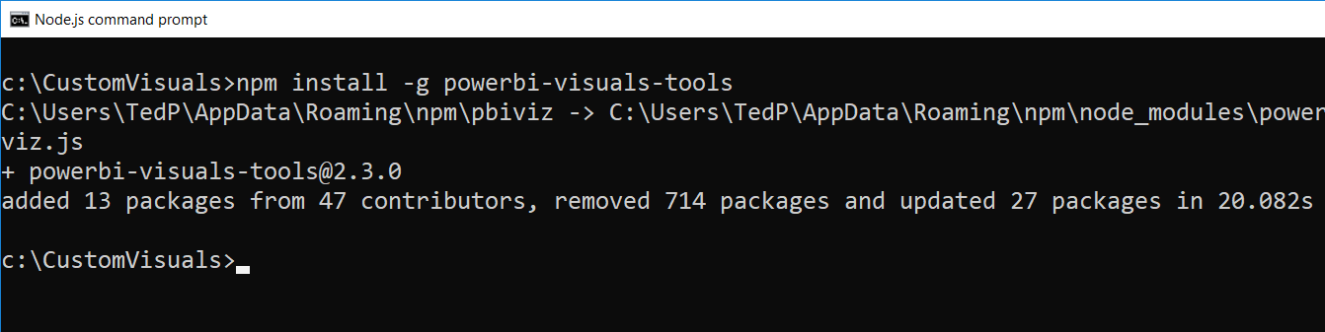
Power BI Visual CLI Tool (PBIVIZ)
What is the Power BI Custom Visual Tool?
Command-line utility for cross-platform dev
Use it with Visual Studio or Visual Studio Code
Requires that you first install node.js
Install by running command from node.js command prompt
npm install -g powerbi-visuals-tools

Slide 21
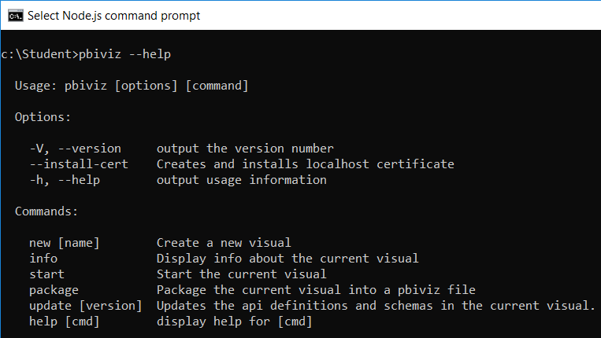
Getting Started with PBIVIZ
PBIVIZ.EXE is a command-line utility
You execute PBIVIZ commands from the NODE.JS command line

Slide 22
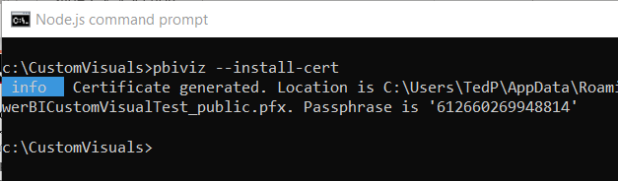
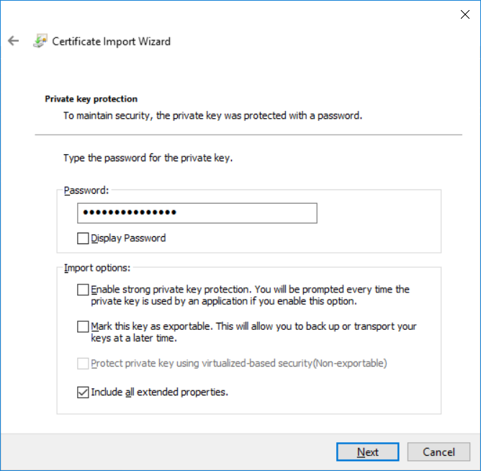
Creating a Certificate for Local Testing
PBIVIZ provide local web server for testing & debugging
Web server runs locally on developer's workstation in Node.js
Makes it possible to test custom visuals in Power BI Service
Custom visual resources served up from https://localhost
Setup requires creating self-signed SSL certificate
SSL certificate created using pbiviz --install-cert command
You must copy a passphrase to properly install the certificate

Slide 23
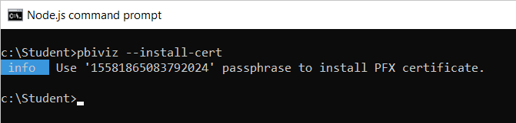
Installing the SSL Certificate
Installing certificate enables SSL through https://localhost
Installing certificate is a one time operation – not once per project
SSL certificate installed using pbiviz --install-cert command
Running --install-cert command starts Certificate Import Wizard

Slide 24
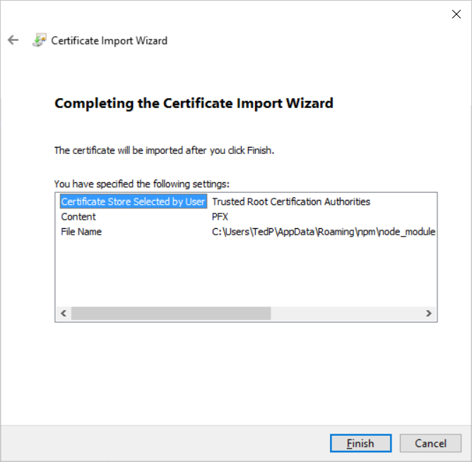
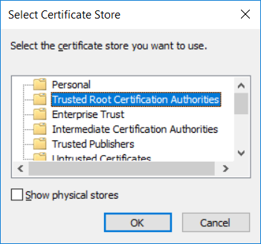
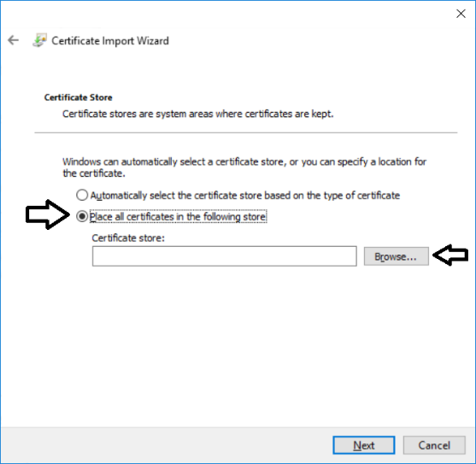
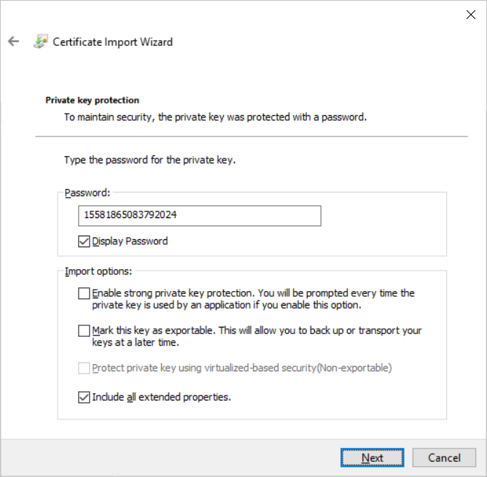
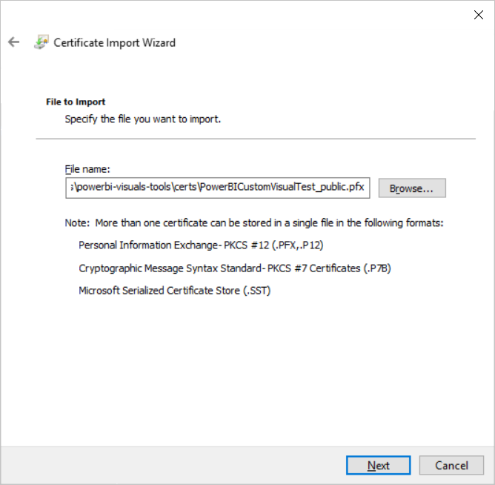
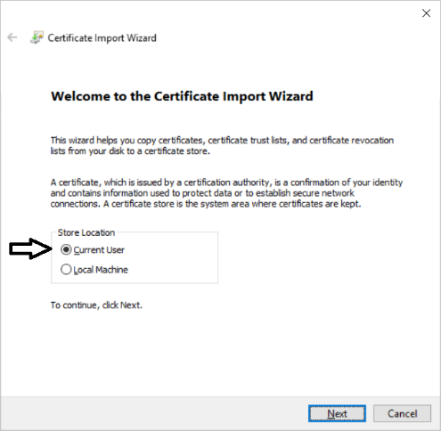
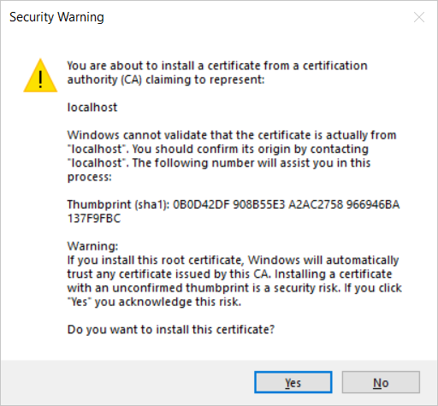
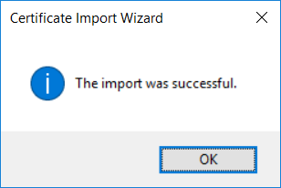
The Certificate Import Wizard
Wizards steps you through process of installing certificate
You enter certificate passphrase as part of installation process

Slide 25
Agenda
Installing the Power BI Developer Tools
Creating Your First Custom Visual
Defining Data Roles and Data Mappings
Extending a Visual with Custom Properties
Migrating to Version 3 of the Power BI Developer Tools

Slide 26
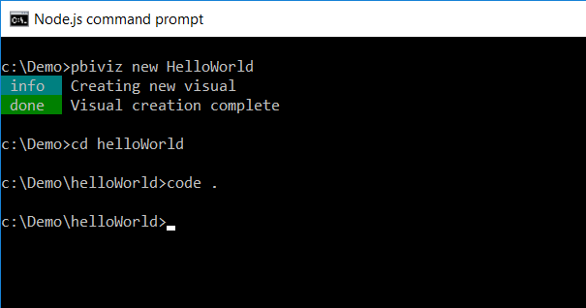
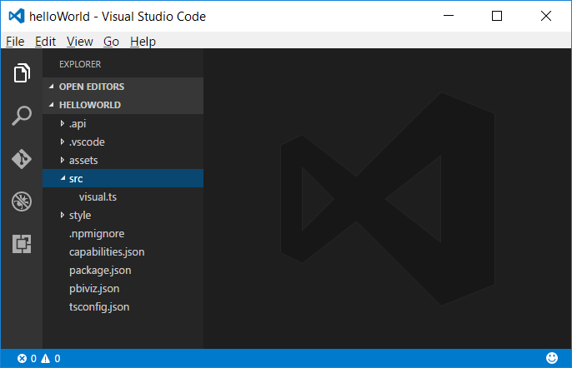
Creating a New Custom Visual Project
Creating a new project
pbiviz new <ProjectName>
Open the Project with Visual Studio Code
code .

Slide 27
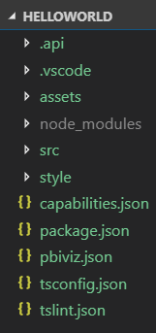
Top-level project files
package.json
Used by npm to manage packages
pbiviz.json
Main manifest file for your custom visual project
capabilities.json
File used to define visual capabilities
tsconfig.json & tslint.json
Typescript compiler settings

Slide 28
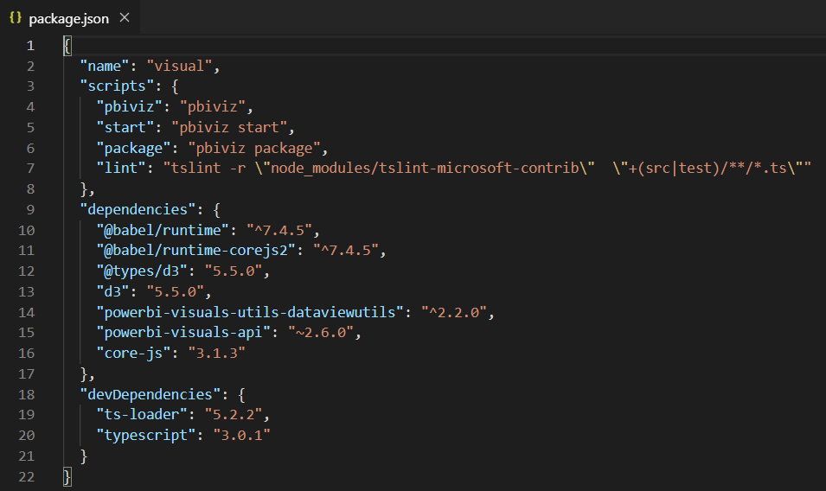
Package.json

Slide 29
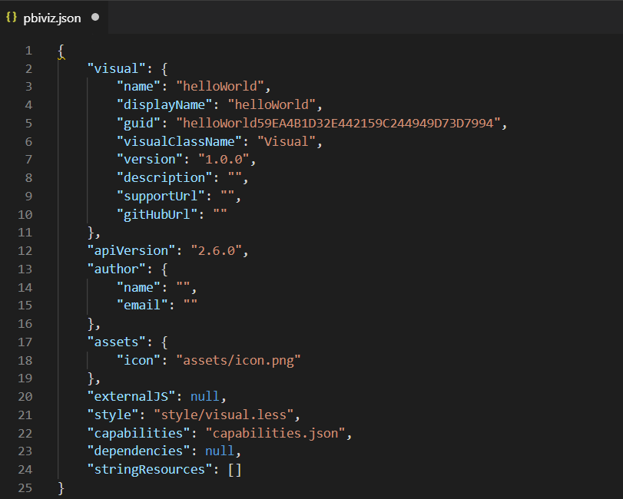
The pbiviz.json File
Acts as top-level manifest file for custom visual project
Indicates which version of the Custom Visual API is used

Slide 30
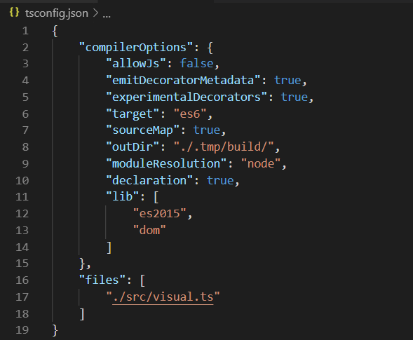
The tsconfig.json File
Used to add references to other TypeScript files
Controls which TypeScript files are passed to TypeScript compiler
No need to reference *.d.ts files in the node_modules/@types folder

Slide 31
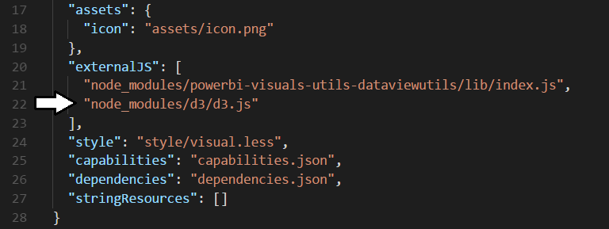
Installing D3 when using PBIVIZ Version 2
Install package for D3 library version 3.x
npm install d3@3 --save-dev
Install package for type definition files version 3
npm install @types/d3@3 --save-dev
Update externalJS section of pbiviz.json

Slide 32
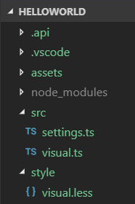
Visual Source Files
visual.ts
visual class definition
settings.ts
helper class to manage visual properties
visual.less
CSS used to style custom visual

Slide 33
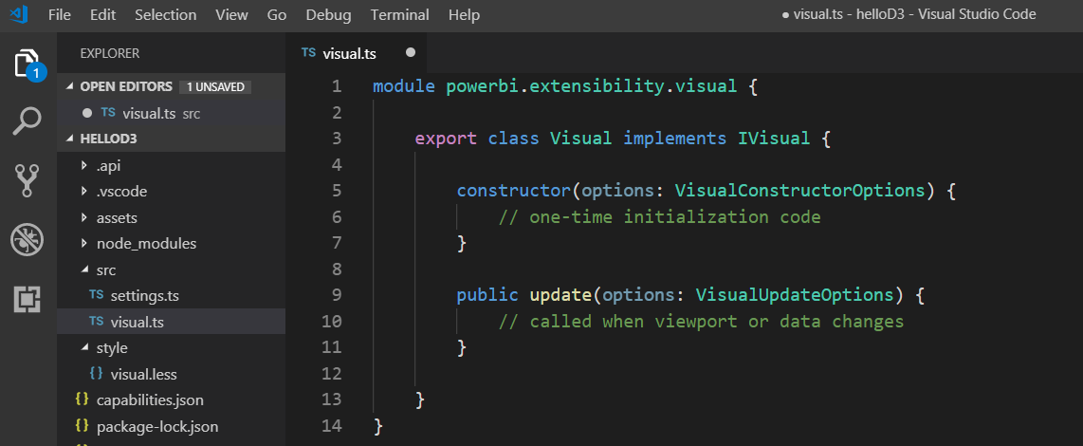
Authoring a Custom Visual Class
Custom visual is a class that implements IVisual
Class must be defined in powerbi.extensibility.visual namespace
Minimum visual class must provide update method
Parameterized constructor used to create visual elements

Slide 34
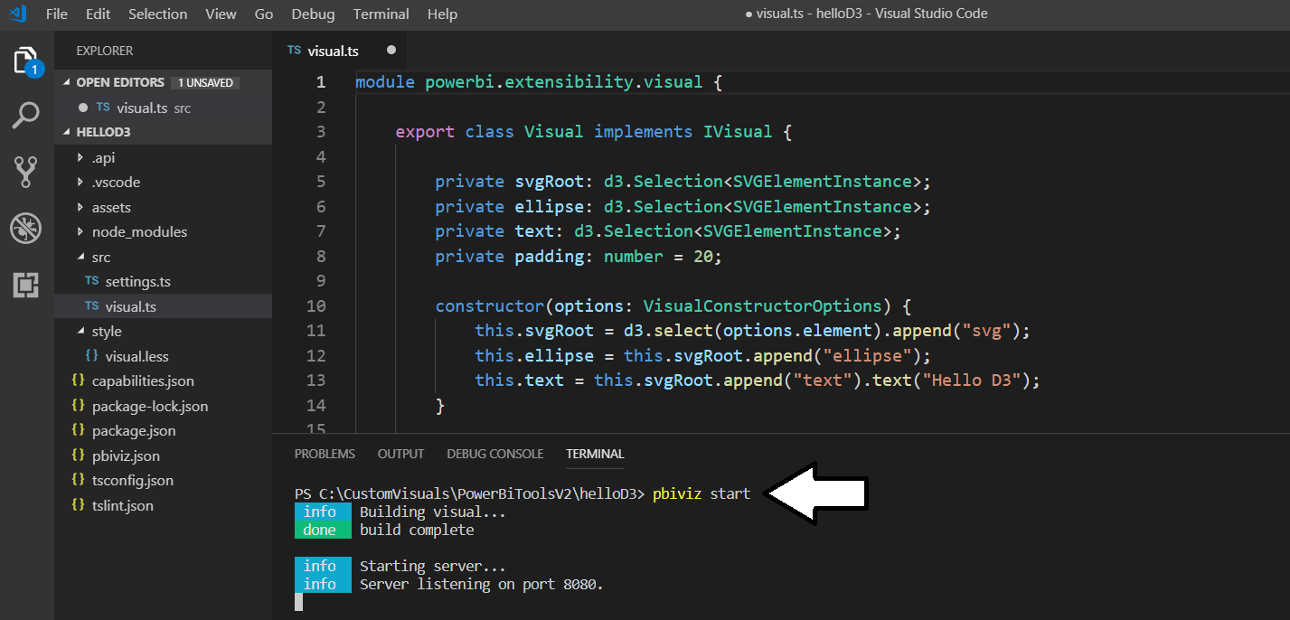
Running a Custom Visual Project
Visual projects run & tested using pbiviz start command
Run pbiviz start from Visual Studio Code from Integrated console
Command starts local debugging session in node.js

Slide 35
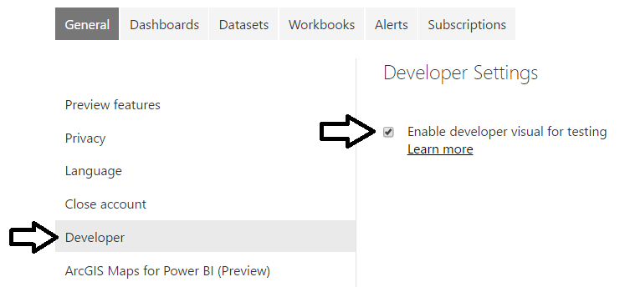
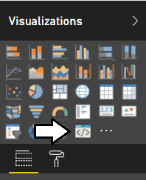
The Developer Visual
Must be enabled on Developer Settings page
Provides new visual for testing and debugging custom visuals

Slide 36
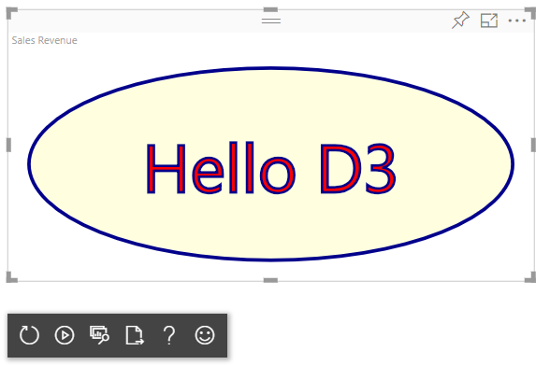
Working with the Developer Visual
Developer visual loads custom visual from node.js
Makes it possible to test custom visual inside Power BI Service
Developer visual provides toolbar with development utilities

Slide 37
Agenda
Installing the Power BI Developer Tools
Creating Your First Custom Visual
Defining Data Roles and Data Mappings
Extending a Visual with Custom Properties
Migrating to Version 3 of the Power BI Developer Tools

Slide 38
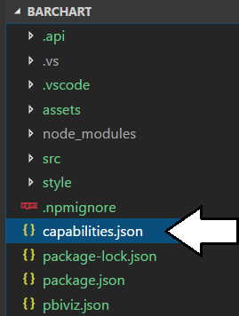
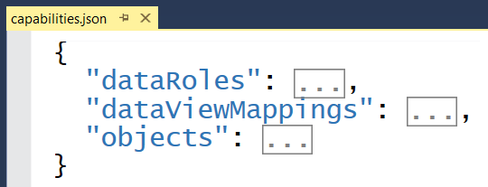
Visual Capabilities
Visual capabilities defined inside capabilities.json
dataRoles defines the field wells displayed on Fields pane
dataViewMappings defines the type of DataView used by visual
objects defines custom properties for visual

Slide 39
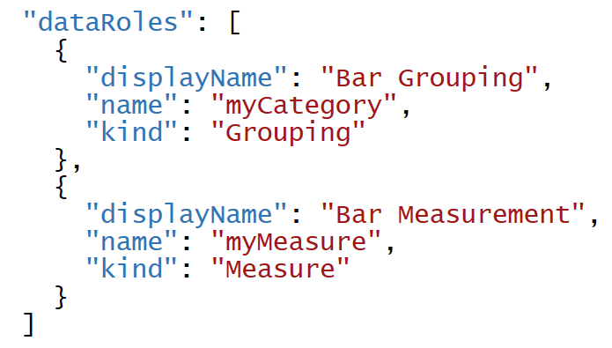
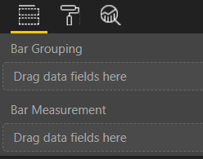
Data Roles
DataRoles define how fields are associated with visual
Each dataRole is display as field well in the Field pane
dataRoles can be defined with conditions and data mappings

Slide 40
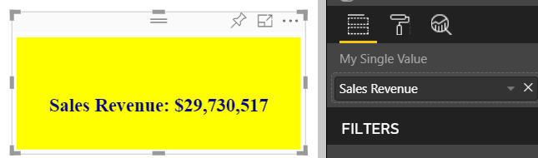
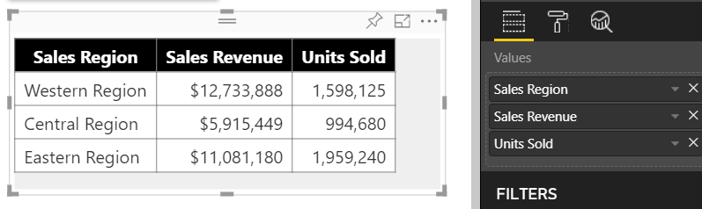
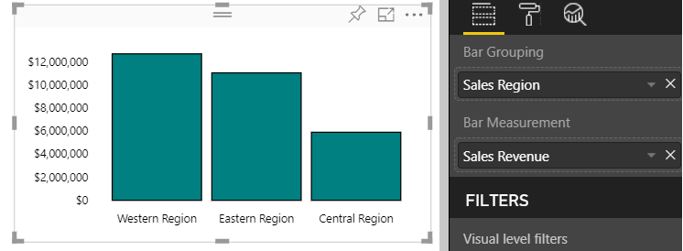
Data Mapping Modes
Power BI visual API provides several mapping modes
Single
Table
Categorical
Matrix
Tree
Single Mapping
Table Mapping
Categorical Mapping

Slide 41

Developer Visual DataView
Developer visual supports DataView mode
Allows you to see and explore data mapping
Allows you to see metadata for custom properties

Slide 42

Designing with View Model
Best practice involves creating view model for each visual
View model defines data required for rendering
createViewModel method gets data to generate view model
update method calls createViewModel to get view model

Slide 43

Single Mapping Example: oneBigNumber
dataRole can use dataViewMapping mode of single
For visuals like Card which only display single value
Condition can define that a dataRole requires exactly one measure

Slide 44


Programming in Single Mapping Mode
Single mapping easy to access through visuals API
DataView object provides single.value property
value property defined as PrimativeValue { bool | number | string }
PrimativeValue must be explicitly cast
Other measure properties available through column metadata

Slide 45





Using the Power BI Formatting Utilities
Used to format values using Power BI formatting strings
Requires installing powerbi-visuals-utils-formattingutils package

Slide 46

Table Mapping Example: Snazzy Table
dataRole can use dataViewMapping mode of table
For visuals which display rows & columns for ordered set of fields
condition can define number of fields that can be added

Slide 47


Programming in Table Mapping Mode
Table mapping data accessible through visuals API
DataView object provides table property
table property provides columns property and rows property

Slide 48

Categorical Mapping Example: Barchart
dataRole can use dataViewMapping mode of categorical
This is the most common type of data mapping
For visuals which divide data into groups for analysis
Groups defined as columns and values defined as measures

Slide 49
Agenda
Installing the Power BI Developer Tools
Creating Your First Custom Visual
Defining Data Roles and Data Mappings
Extending a Visual with Custom Properties
Migrating to Version 3 of the Power BI Developer Tools

Slide 50


Extending Visuals with Custom Properties
Custom properties defined using objects
You can define one or more objects in capabilities.json
Each object defined with name, display name and properties
object properties automatically persistent inside visual metadata
properties can be seen and modified by user in Format pane
Custom properties require extra code to initialize Format pane

Slide 51

DataViewObjectParser and VisualSettings
Power BI visual utilities provide DataViewObjectParser
Abstracts away tricky code to initialize and read property values

Slide 52
Mapping Object Properties to VisualSettings
VisualSettings class must map to named objectnamed
VisualSetting class contains named field that maps to object name
Named field based on custom class with mapped properties
Object & property names must match what's in capabilities.json

Slide 53

Initializing Objects in the Format Pane
Visual must initialize properties in Format pane
Visual must implement enumerateObjectInstances
VisualSettings makes this relatively easy
Extra code required to make property appear as spinner

Slide 54


Retrieving Property Values
Property values persisted into visual metadata
Properties not persisted white they still retain default values
Property values retrieved using VisualSettings object

Slide 55
Agenda
Installing the Power BI Developer Tools
Creating Your First Custom Visual
Defining Data Roles and Data Mappings
Extending a Visual with Custom Properties
Migrating to Version 3 of the Power BI Developer Tools

Slide 56

Tools v2
Power BI API added to your project
Power BI API files added to project
You install packages for utilities
Add externalJS entries for JavaScript libraries required on page

Slide 57
EcmaScript2015 Modules and D3 version 5
ECMAScript 2015 add modules to JavaScript
TypeScript builds on the concept
Each file defines it own module
Modules execute in their own scope not at global scope
Code in module not visible to other modules by default
Classes and function must be exported to use across modules
Modules must import types from other modules
relationships between modules defined using imports and exports

Slide 58



Dynamic Module Loading
Webpack controls dynamic module loading
Your project just references app.ts
Compiler dynamically determines other files to include

Slide 59
WebPack
WebPack serves as a bundling utility
Bundles many js/ts files into a single file
Can handle dynamic module loading
Provides a dev server for testing and debugging
When using Webpack 4
Install packages for webpack and webpack-cli
npm install webpack webpack-cli --save-dev

Slide 60
Working with the V3 Tools

Slide 61
Summary
Installing the Power BI Developer Tools
Creating Your First Custom Visual
Defining Data Roles and Data Mappings
Extending a Visual with Custom Properties
Migrating to Version 3 of the Power BI Developer Tools

